Slide 1
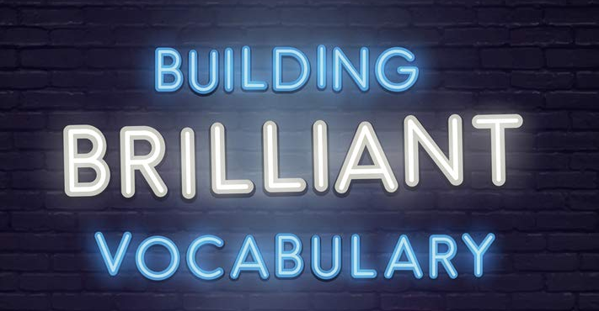
Notes:
Consider having a specific seating plan with more able sat with a less able or year 7/8 sat with year 10/11 for vocab lessons.
As students get more familiar, the older / more able students could have the resources in advance and be expected to teach the other student.
However, to start with remember you will have to model the process and teach them how to do this.
Teachers need copy of the book and students need activity booklet –one each – get them to write their names on the booklet
Any reading can either be modelled by the teacher, a student reading, done in pairs or shared around the class. Choose the best strategies for your group but ensure you move swiftly – e.g. if class reading, say the student’s name only to move on to the new reader. Vary the amount they should read – one sentence / one paragraph depending on ability. Come back to the teacher reading periodically or to model good reading / pick up the pace.
Students should demonstrate they are following with their finger / pen / a ruler throughout the lesson.
You won’t get through all the tasks – certainly to start with, but as students get familiar with the structure of the lessons, the pace should increase.
The activities move through the SEEC structure – the word has been selected, you will explain the word and then explore and consolidate their understanding together.

Slide 2

Learning Objectives
Be able to use the word in a sentence
Understand the meaning of the word
Know the word (be able to read and pronounce it)
SO THAT…
I can understand how the word is used in a text, use it in my own writing and improve my vocabulary.
Notes:
Objectives are rated bronze – gold – top is most difficult. “So that..” is the outcome – the reason why they are doing this
1 minute

Slide 3


Introduce the word:
Hierarchy
Noun : Hierarchy
Adjective: Hierarchical
Notes:
Introduce the word
Call and response: ask students “Repeat after me: xxxxx” Repeat until secure
Differentiation: write the word on the board and segment the word into graphemes / syllables
Ask the question – “what does XXXXXXX mean?” get them thinking but don’t take responses (keep the pace quick). Explain that they are going to read a story to exemplify the meaning of the word.
Help – remember a noun is a thing – it can be abstract but it is the name we give something. And adjective describes a noun – we need to use this word class to use the word to apply the concept to something or someone else – to describe them. A verb is an action – what we do.
1 minute

Slide 4
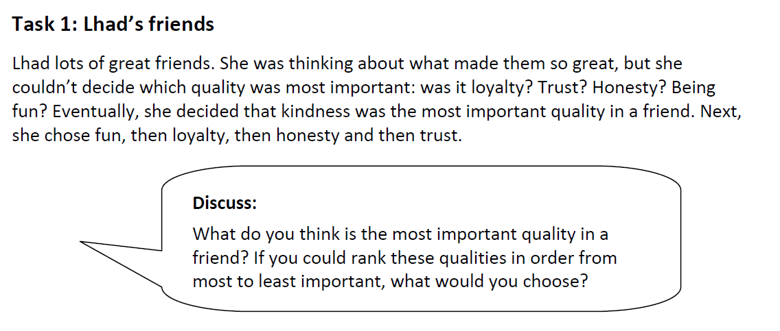
Word example: read the story and discuss
Notes:
Read the story.
Options: Teacher read the story. / Students read the story in pairs / one student reads to the class.
Can take feedback from one or two students on the discussion point.
2 minutes

Slide 5
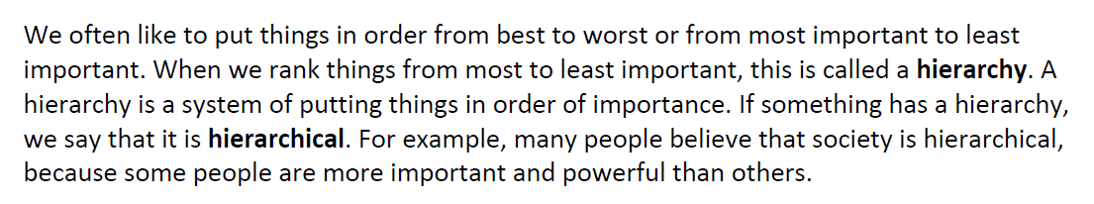
Introduce the meaning:
Definition:
Hierarchy is a system of putting things in order of importance.
Definition:
Hierarchy is…
Notes:
SEEC: Explain the word
Reading should be shared around the class. Move swiftly – say the student’s name only to move on to the new reader. Vary the amount they should read – one sentence / one paragraph depending on ability. Come back to the teacher reading periodically or to model good reading / pick up the pace. Students should demonstrate they are following with their finger / pen / a ruler.
Read the definition – get students to repeat back to you. Could do call and response: Teacher “Hierarchy is is…” Students complete chorally.
As your students get more confident, you may ask them to give you the definition
Differentiation for weak students: Check for understanding of the basic meaning – ask why / how does each example relate to this word. Refer to the definition for each word. For example: “John, What is the example of hierarchy in the story? / Why is that an example of a hierarchy?”
2 minutes

Slide 6
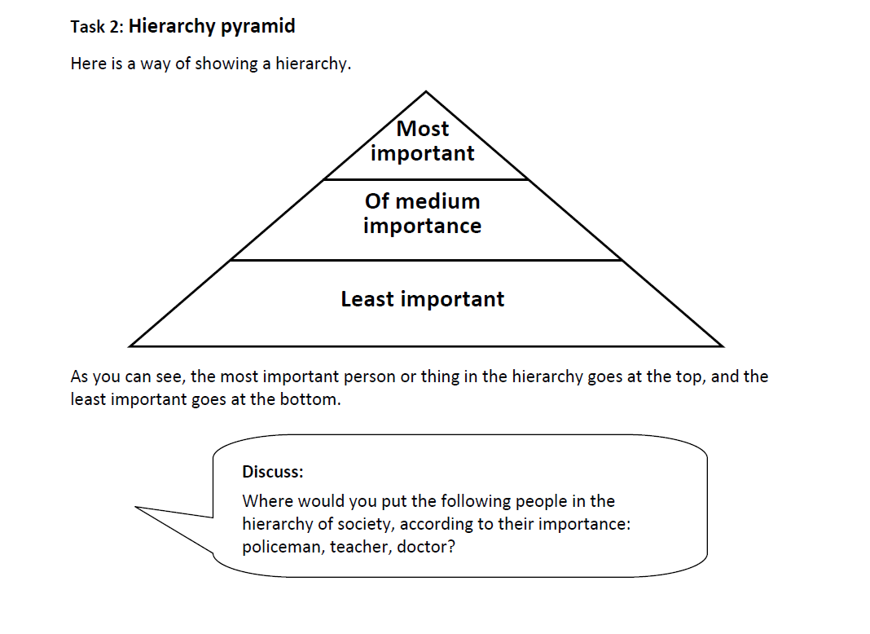
Using the word:
Notes:
SEEC: Explore the word
This section prevents misconceptions and allows students to practise hearing, saying, using and applying the word.
Teacher or student read the info. Student read discussion question.
Can do in pairs: give one minute for the activity in pairs and one minute for feedback or as a whole class
2 minutes

Slide 7
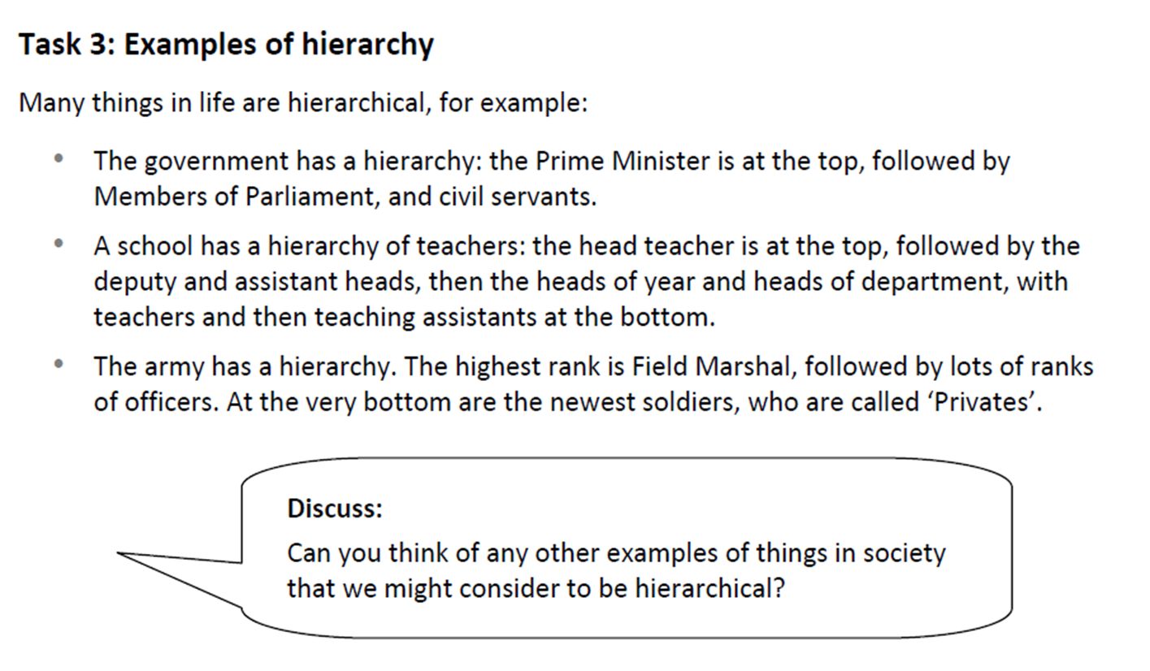
Using the word:
Notes:
This section prevents misconceptions and allows students to practise hearing, saying, using and applying the word.
Teacher or student read the info. Student read discussion question.
Egs – business, royal family etc.
Can do in pairs: give one minute for the activity in pairs and one minute for feedback or as a whole class
2 minutes

Slide 8

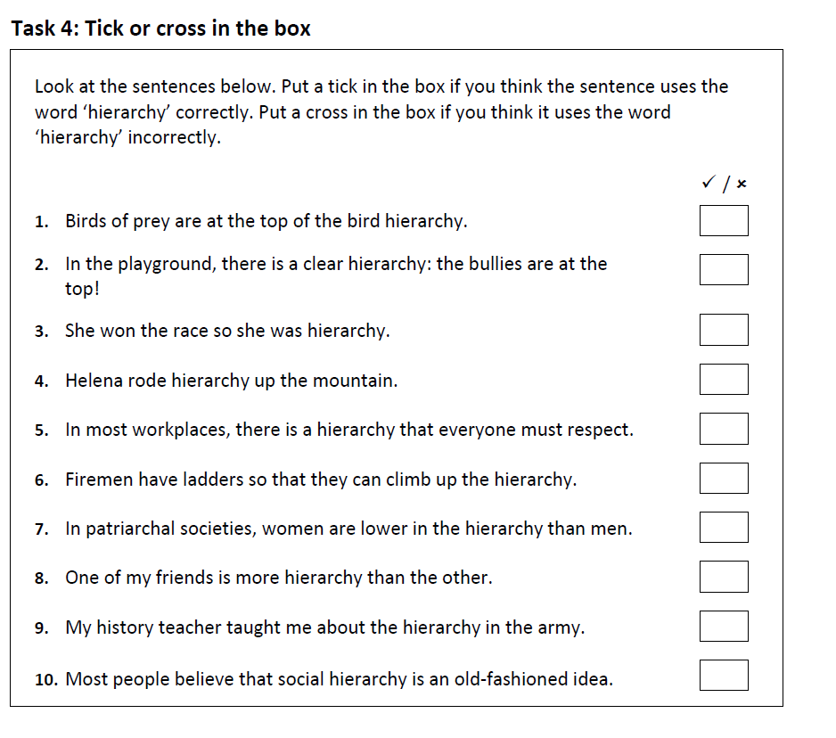

Check our understanding:
Challenge: Can you correct the incorrect examples?
Notes:
This section allows teachers to check for understanding
Students can do individually.
Check first one is correct as a class before moving on to subsequent examples
Teacher can circulate to check answers or get students to self mark after or students can chorally call out “correct” / “incorrect”
Answers are in the teacher booklet. Correct: 1, 2, 5, 7, 9, 10. Incorrect: 3, 4, 6, 8
Class call out of “correct” / “incorrect”
2 minutes

Slide 9
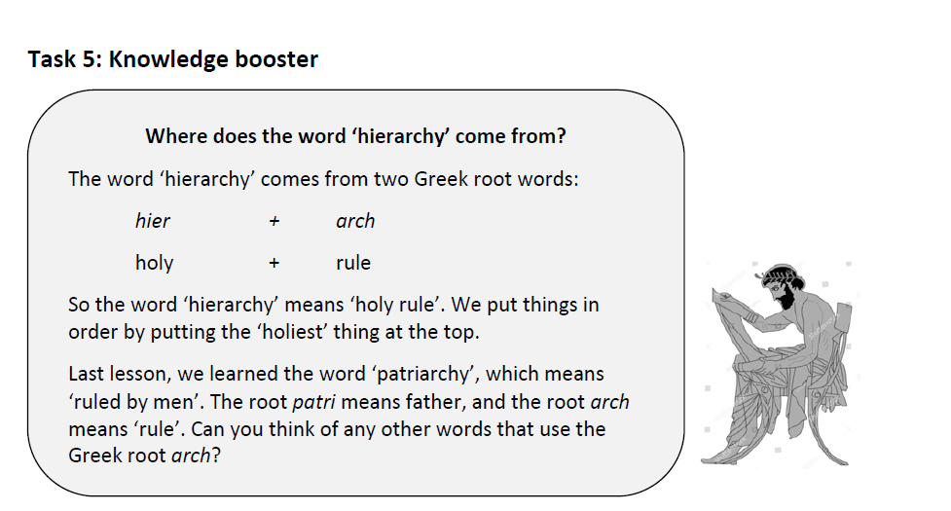
Knowledge boost:
Notes:
Whole class – teacher leads.
Explain that they did not look at the word patriarch last lesson but hands up if thy have come across this word before?
Examples that contain the root Arch – monarch, monarchy, oligarch, oligarchy, matriarch, anarchy, archive etc.
https://membean.com/wrotds/arch-rule

Slide 10
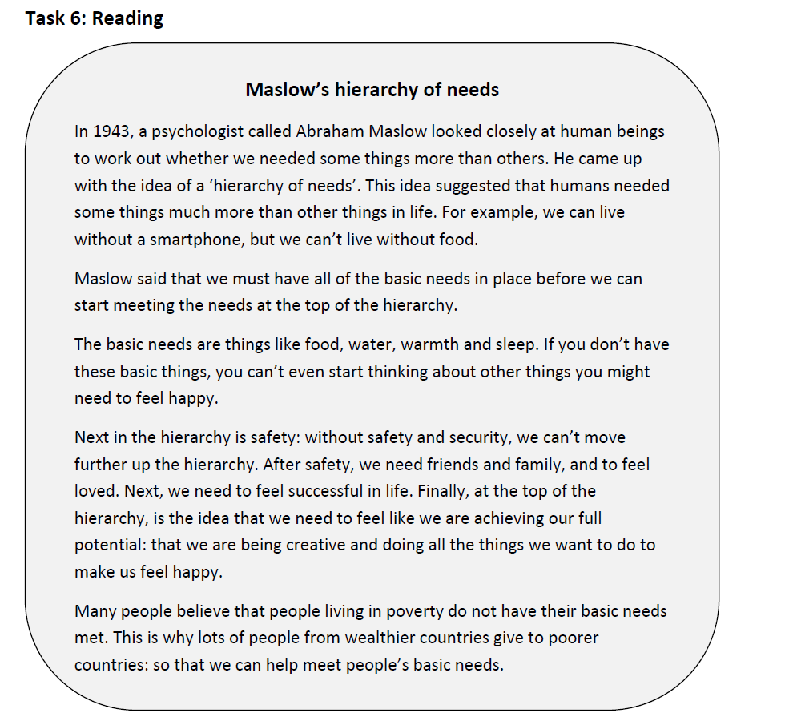
Read about the word:
Notes:
Whole class task
Skip this if short of time. (The aim is to develop their contextual and cultural understanding of the word.)
Reading should be shared around the class. Move swiftly – say the student’s name only to move on to the new reader. Vary the amount they should read – one sentence / one paragraph depending on ability. Come back to the teacher reading periodically or to model good reading / pick up the pace. Students should demonstrate they are following with their finger / pen / a ruler.
Prepare student friendly explanations for any words you don’t expect students to know.
4 minutes

Slide 11
Notes:
Questions you could ask to check understanding:
So what are our most important needs?

Slide 12
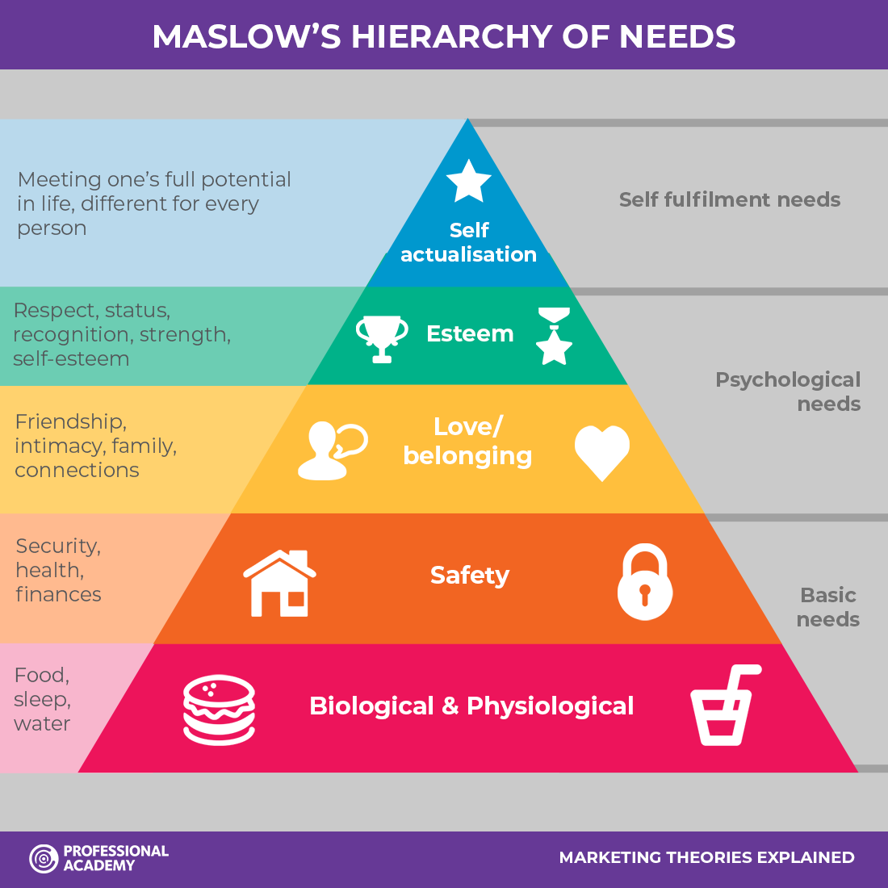
Notes:
Diagram if you wish to use this to help students’ understanding

Slide 13
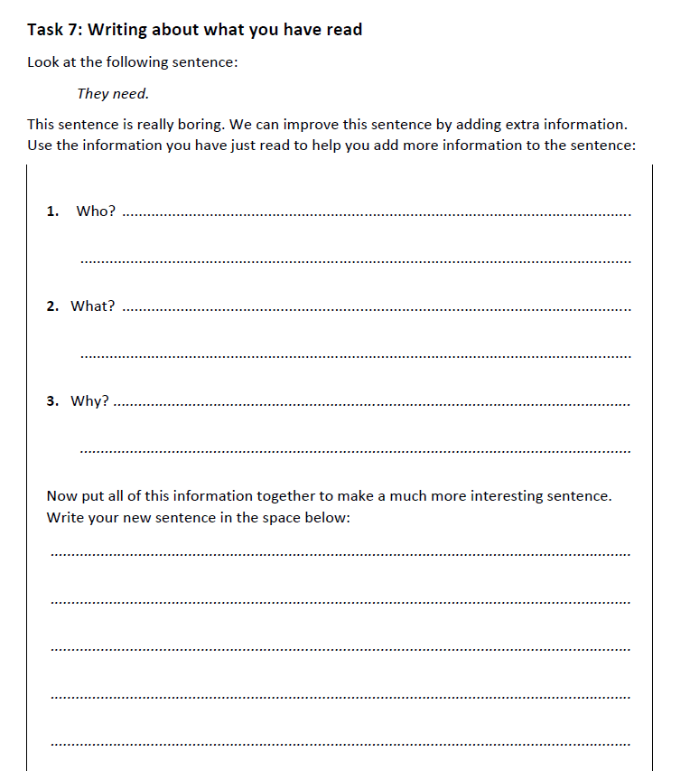
Write about the word:
Notes:
The aim is for students to consolidate their understanding and use the word in their writing
Independent or pair task.
The aim of this task is to get students to summarise and consolidate their new learning.
See teacher notes for example answers.
Students can fill in the sheet in pairs, taking it in turns to complete.
If students are sat in different ability groups, the more able student could ask the less able and the more able could be the scribe, writing down their answer and then getting them to read it back and ask them if they are happy with it or point out any improvements.
The teacher could model this process to start with.
3 minutes – leaves one minute to pack away

